Slide 1
Hypothesis Testing II
Statistical Data Analysis, 2023

Slide 2

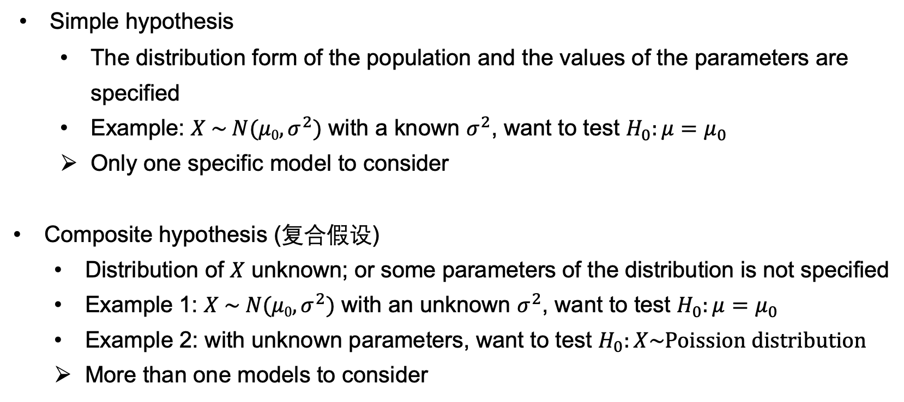
Types of Null Hypothesis
Simple hypothesis
The distribution form of the population and the values of the parameters are specified
Example: $X \sim N(μ0, σ^{2})$ with a known $σ^{2}$, want to test $H_{0}:μ=μ_{0}$
Only one specific model to consider
Composite hypothesis (复合假设)
Distribution of $X$ unknown; or some parameters of the distribution is not specified
Example 1: $X \sim N(μ0, σ^{2})$ with an unknown $σ^{2}$, want to test $H_{0}:μ=μ_{0}$
Example 2: with unknown parameters, want to test $H_{0}:X\sim Poission distribution$
More than one models to consider

Slide 3
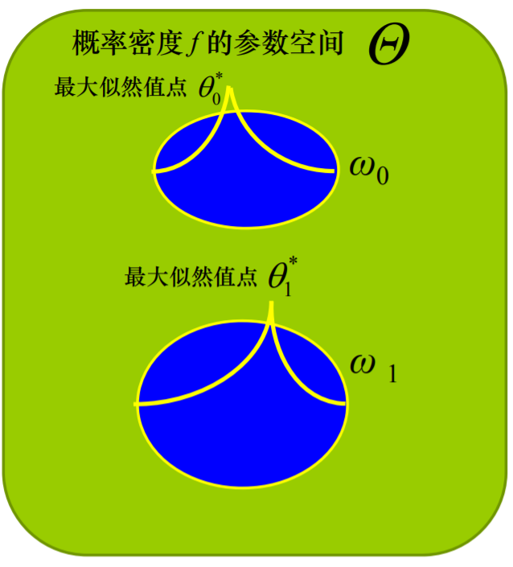

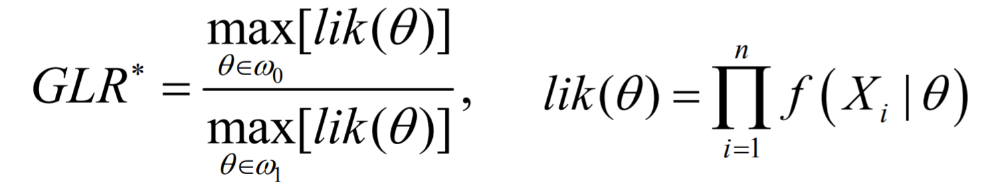
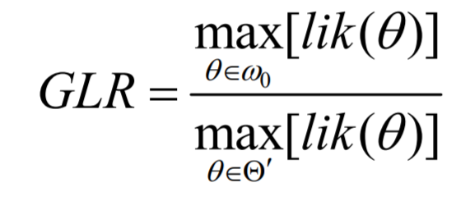

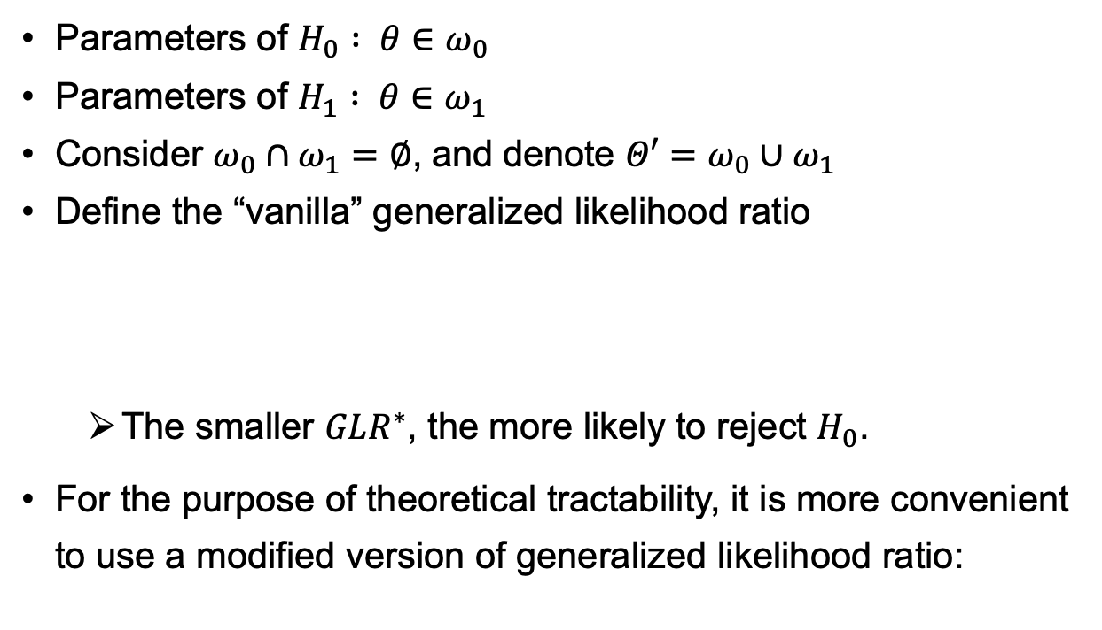
Generalized Likelihood Ratio Test (广义似然比检验)
Parameters of $H_{0} : θ∈ω_{0}$
Parameters of $H_{1} : θ∈ω_{1}$
Consider $ω_{0}∩ω_{1}=∅$, and denote $Θ′=ω_{0}∪ω_{1}$
Define the “vanilla” generalized likelihood ratio
The smaller $GLR^{∗}$, the more likely to reject $H_{0}$.
For the purpose of theoretical tractability, it is more convenient to use a modified version of generalized likelihood ratio:
$$Θ′$$
Notes:
GLR* -> pick the two best parameters in the two regions to compare.

Slide 4
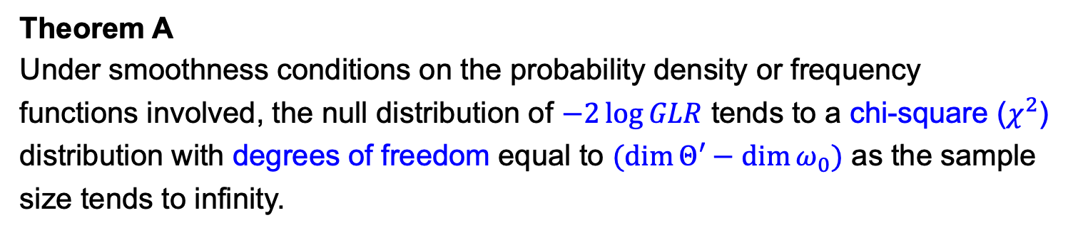
Generalized Likelihood Ratio Test
Generalized likelihood ratio
Theorem A
Under smoothness conditions on the probability density or frequency functions involved, the null distribution of $−2\log{GLR}$ tends to a chi-square ($χ^{2}$) distribution with degrees of freedom equal to $(\dim{Θ′−\dim{ω_{0}}})$ as the sample size tends to infinity.
[Ref: Chapter 9, MSDA3 - J. A. Rice]
Notes:
No. of parameters estimated from data -> no. of degree of freedom loss

Slide 5
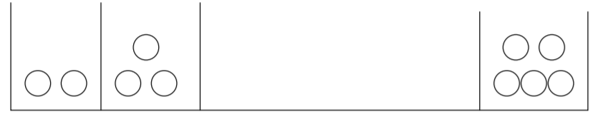
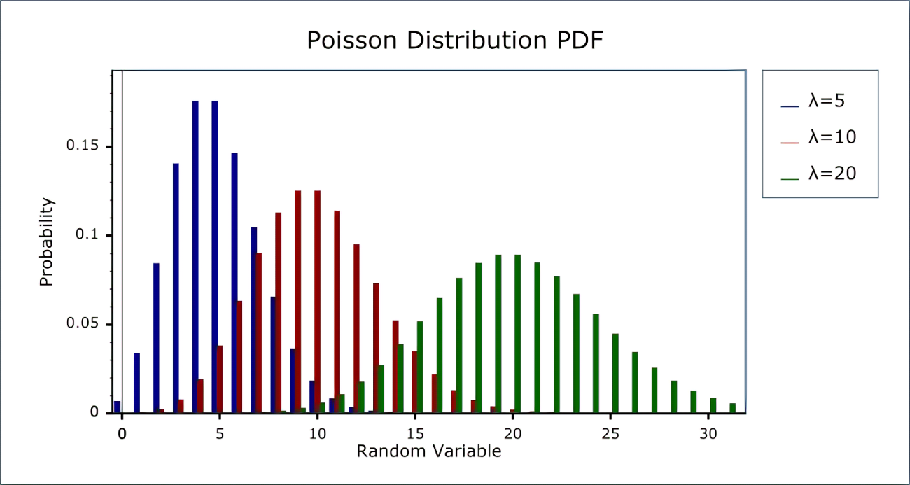
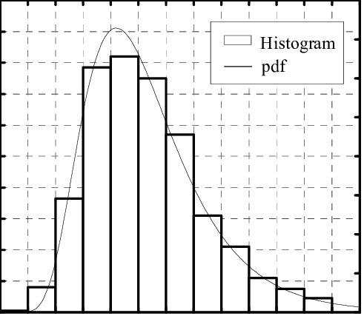

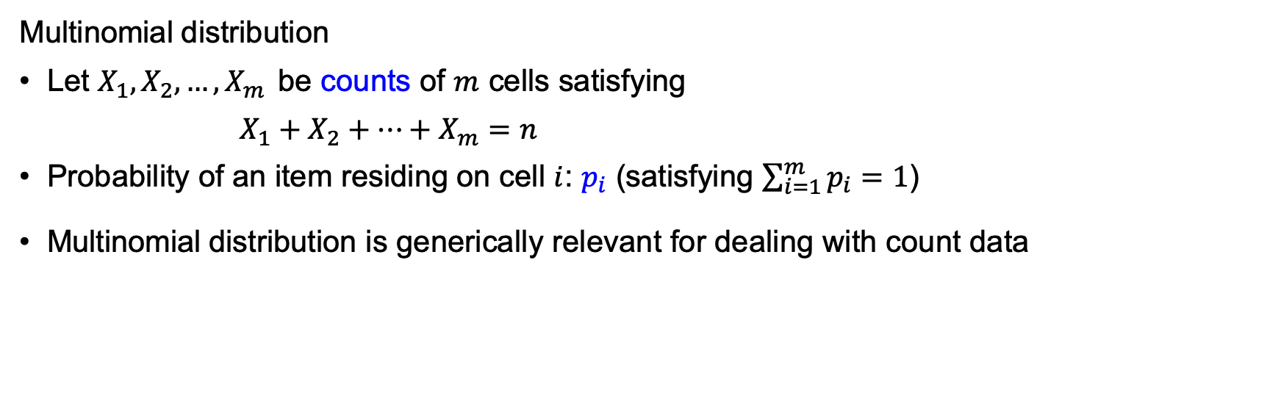


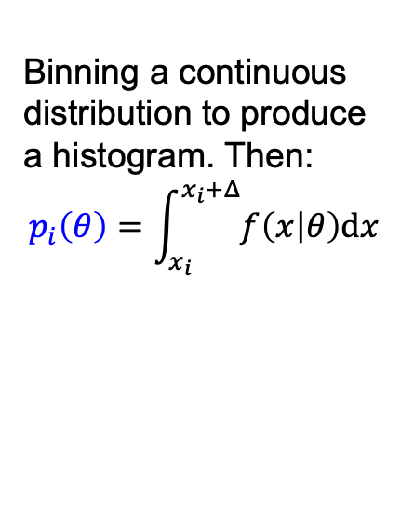
GLR Test for Multinomial Distribution
Multinomial distribution
Let $X_{1},X_{2},…, X_{m}$ be counts of $m$ cells satisfying
$X_{1}+X_{2}+⋯+X_{m}=n$
Probability of an item residing on cell $i$: $p_{i}$ (satisfying $\sum_{i=1}^{m}{p_{i}}=1$)
Multinomial distribution is generically relevant for dealing with count data
Binning a continuous distribution to produce a histogram. Then:
$$p_{i}\left(θ\right)=\int_{x_{i}}^{x_{i}+Δ}{f\left(x | θ\right)dx}$$
$$x_{i}$$
Poisson: $p_{i}(λ)=λ^{i}e^{−λ}/i!$

Slide 6
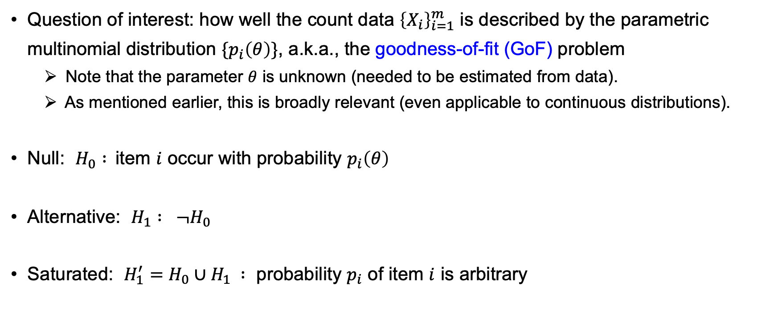
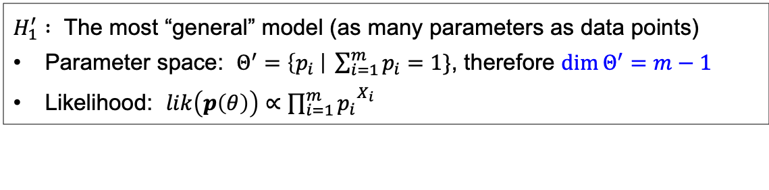
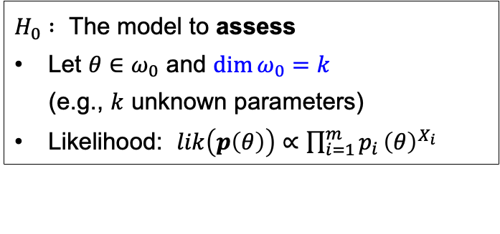
GLR Test for Multinomial Distribution
Question of interest: how well the count data ${\left\{X_{i}\right\}}_{i=1}^{m}$ is described by the parametric multinomial distribution $\{p_{i}\left(θ\right)\}$, a.k.a., the goodness-of-fit (GoF) problem
Note that the parameter $θ$ is unknown (needed to be estimated from data).
As mentioned earlier, this is broadly relevant (even applicable to continuous distributions).
Null: $H_{0} :$item $i$ occur with probability $p_{i}\left(θ\right)$
Alternative: $H_{1} : ¬H_{0}$
Saturated: $H_{1}^{′}=H_{0}∪H_{1} :$ probability $p_{i}$ of item $i$ is arbitrary
$H_{0} :$ The model to assess
Let $θ∈ω_{0}$ and $\dim{ω_{0}}=k$
(e.g., $k$ unknown parameters)
Likelihood: $lik\left(p\left(θ\right)\right)∝\prod_{i=1}^{m}{p_{i}}{\left(θ\right)}^{X_{i}}$
$H_{1}^{′} :$ The most “general” model (as many parameters as data points)
Parameter space: $Θ^{′}=\left\{p_{i} \right| \sum_{i=1}^{m}{p_{i}}=1\}$, therefore $\dim{Θ^{′}}=m−1$
Likelihood: $lik\left(p\left(θ\right)\right)∝{\prod_{i=1}^{m}{p_{i}}}^{X_{i}}$

Slide 7
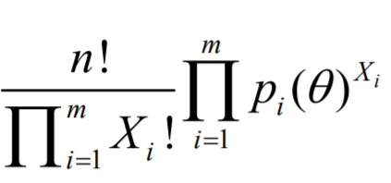
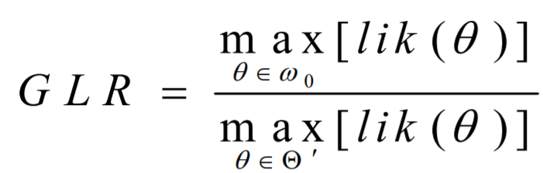
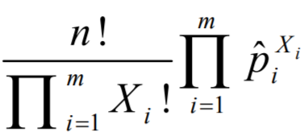
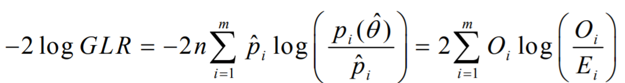
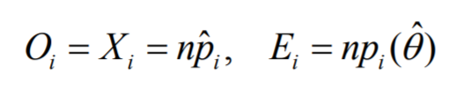
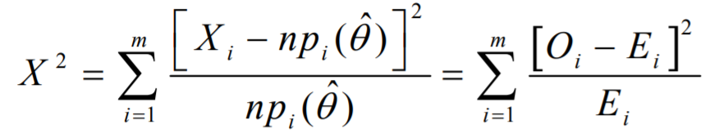
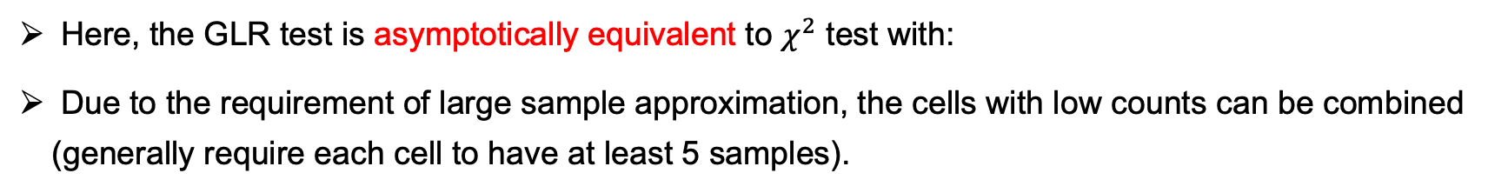

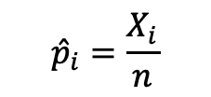
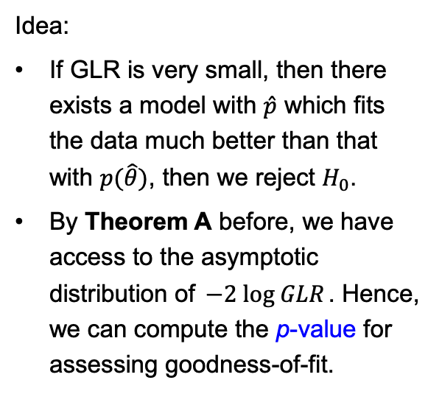


GLR Test for Multinomial Distribution
MLE
Idea:
If GLR is very small, then there exists a model with $\hat{p}$ which fits the data much better than that with $p(\hat{θ})$, then we reject $H_{0}$.
By Theorem A before, we have access to the asymptotic distribution of $−2 log GLR$. Hence, we can compute the p-value for assessing goodness-of-fit.
$$p_{i}\left(\hat{θ}\right)$$
MLE
$${\hat{p}}_{i}=\frac{X_{i}}{n}$$
$$n→∞$$
$$\sim χ^{2}(m−k−1)$$
Here, the GLR test is asymptotically equivalent to $χ^{2}$ test with:
Due to the requirement of large sample approximation, the cells with low counts can be combined (generally require each cell to have at least 5 samples).

Slide 8
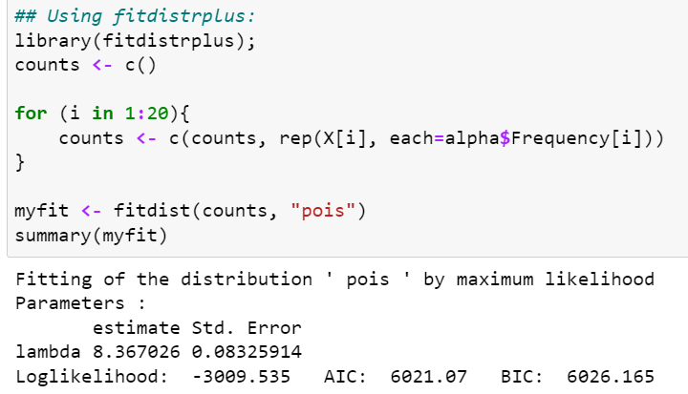
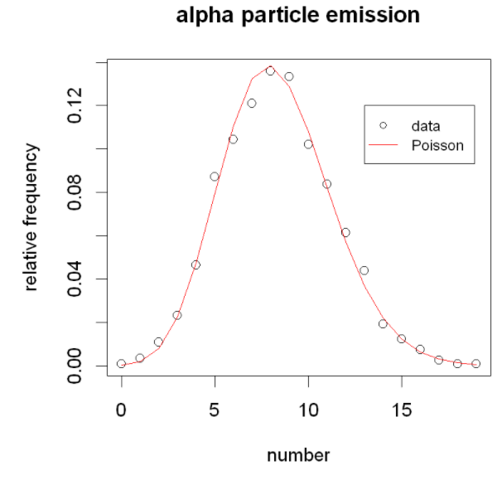
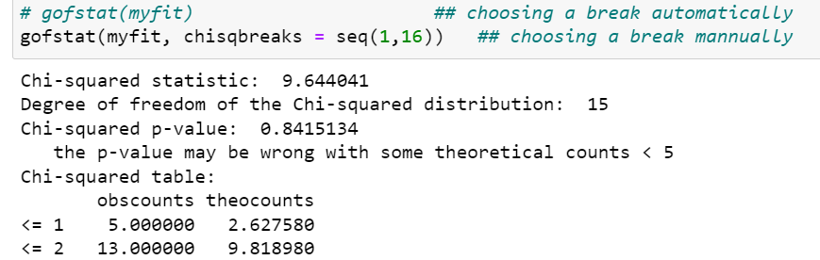
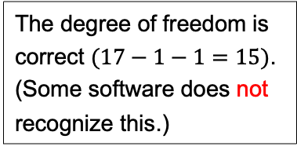
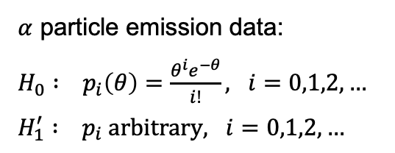
Example: Goodness-of-fit of Poisson by fitdistrplus
Original data is about frequencies of counts.
Need to transfer to raw counts first.
$α$ particle emission data:
$H_{0} : p_{i}\left(θ\right)=\frac{θ^{i}e^{−θ}}{i!}, i=0,1,2,…$
$H_{1}^{′} : p_{i} arbitrary, i=0,1,2,…$
The degree of freedom is correct $(17−1−1=15)$.
(Some software does not recognize this.)
Do not (or not enough evidence to) reject the Poisson fit.
Notes:
In general, “do not reject” does not mean “prove” or “ultimately accept”. It may as well be that the POWER of the test is not high enough to detect the difference between data and fitted.

Slide 9
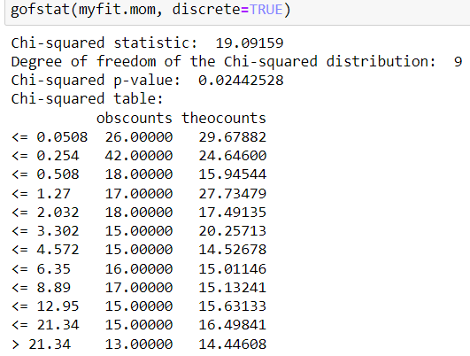
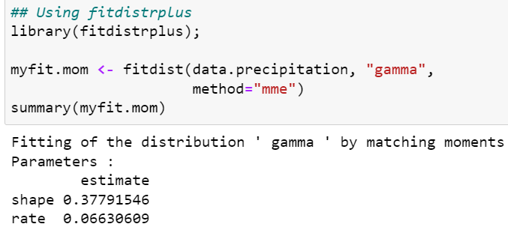
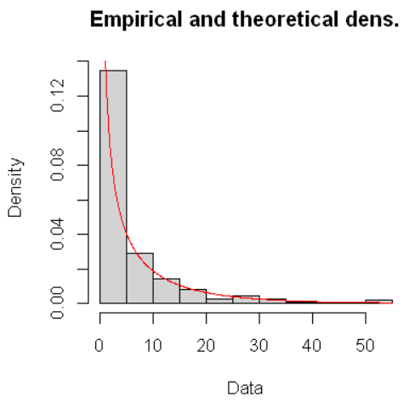
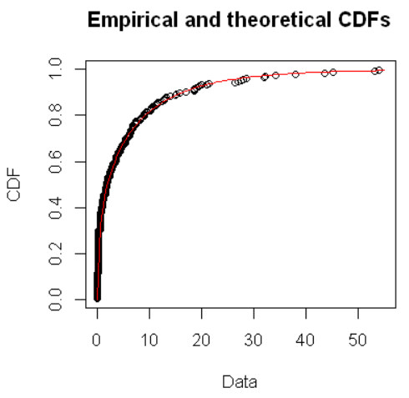
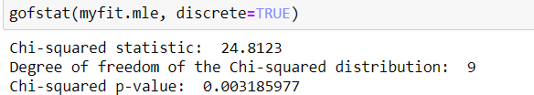
Example: Goodness-of-fit of Gamma by fitdistrplus
Precipitation data
Do you consider the fitting good or bad?

Slide 10
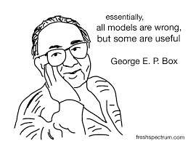
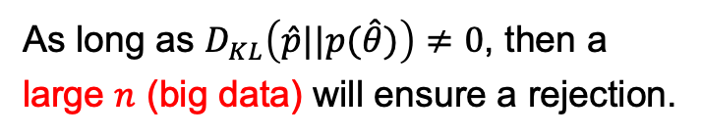
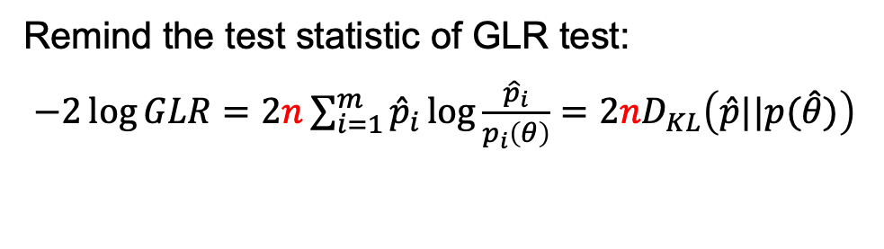
So the test rejects your fitting ?
Sec 9.10, MSDA3 - J. A. Rice :
“…Literally testing for goodness of fit is often rather artificial—a parametric distribution is usually entertained only as a model for the distribution of data values, and it is clear a priori that the data do not really come from that distribution. If enough data were available, the goodness-of-fit test would certainly reject. Rather than test a hypothesis that no one literally believes could hold, it is usually more useful to ascertain qualitatively where the model fits and where and how it fails to fit.”
Comment:
May be an exception if the data is ensured by some physical laws or other fundamental constraints.
Remind the test statistic of GLR test:
$−2\log{GLR}=2n\sum_{i=1}^{m}{{\hat{p}}_{i}}\log{\frac{{\hat{p}}_{i}}{p_{i}\left(θ\right)}}=2nD_{KL}\left(\hat{p}||p(\hat{θ})\right)$
As long as $D_{KL}\left(\hat{p}||p(\hat{θ})\right)≠0$, then a large $n$ (big data) will ensure a rejection.
Notes:
Except if there is some physical law ensuring the data; otherwise, pure phenomenological model seldomly fit the data perfectly.
Text in blue: more constructive advise, rather than simply throwing away the model when rejected.

Slide 11
Assessing Goodness of Fit — Graphical Methods

Slide 12
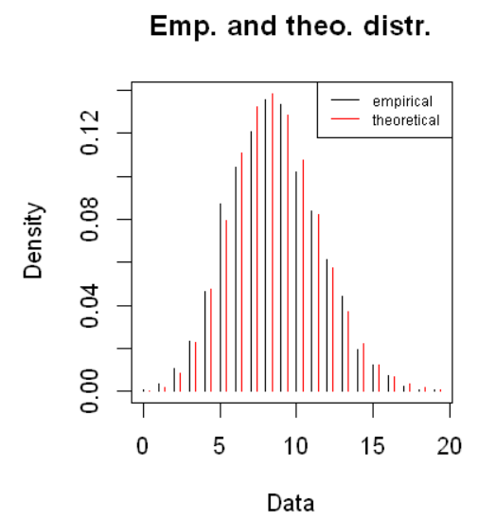
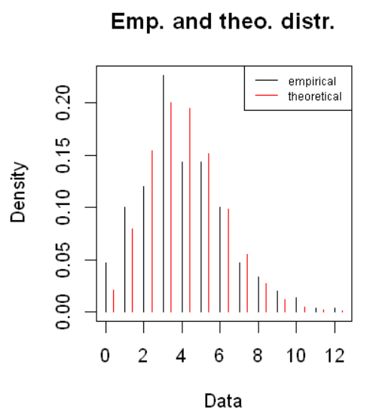

Bar Chart or Histogram
“…it is usually more useful to ascertain qualitatively where the model fits and where and how it fails to fit.”
Poisson fit to $α$ particle emission data
Poisson fit to traffic flow data
Gamma fit to precipitation data
One big problem here:
The cells with large frequencies attracts most of the (visual) attention.

Slide 13
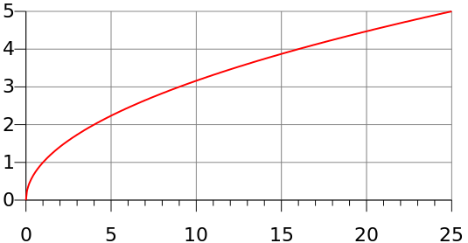
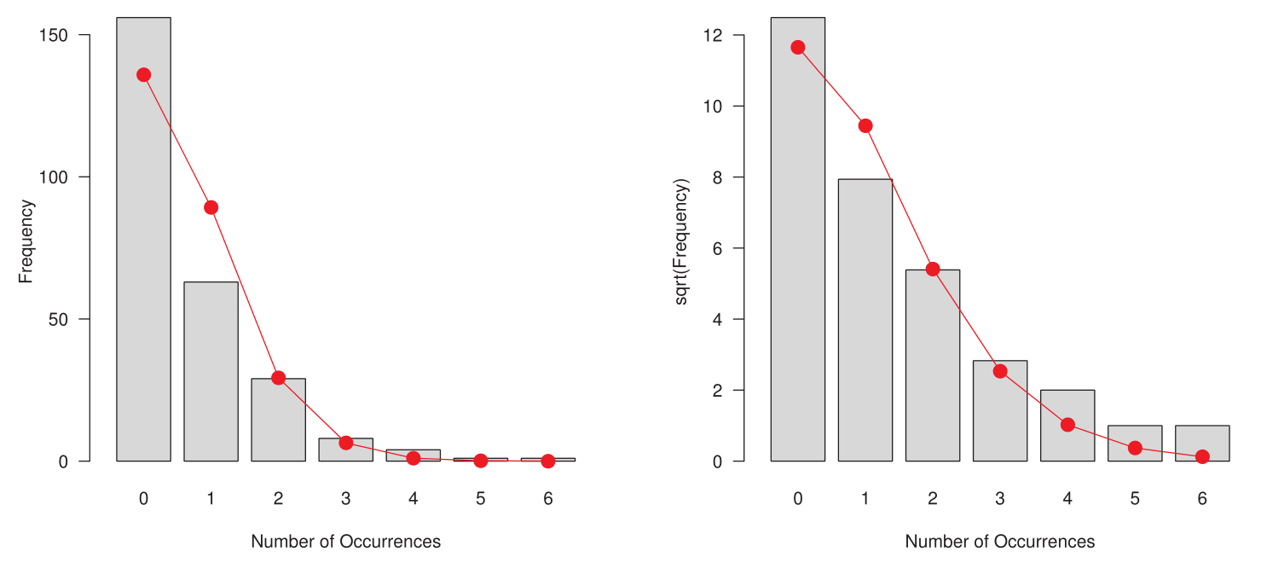
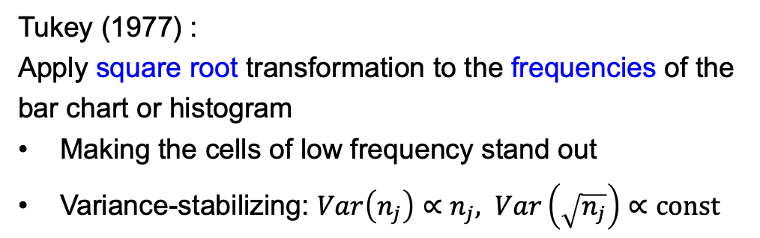

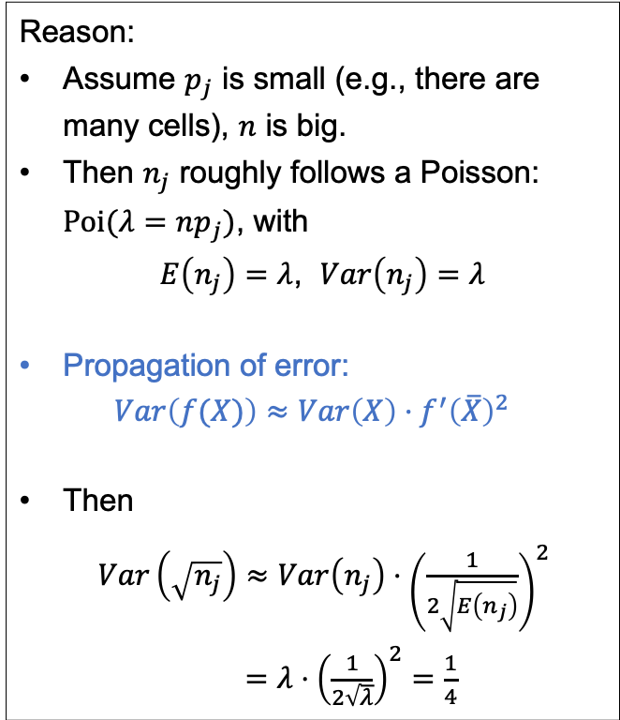
Rootogram
Tukey (1977) :
Apply square root transformation to the frequencies of the bar chart or histogram
Making the cells of low frequency stand out
Variance-stabilizing: $Var\left(n_{j}\right)∝n_{j}, Var\left(\sqrt{n_{j}}\right)∝const$
Reason:
Assume $p_{j}$ is small (e.g., there are many cells), $n$ is big.
Then $n_{j}$ roughly follows a Poisson: $Poi(λ=np_{j})$, with
$E\left(n_{j}\right)=λ$, $Var\left(n_{j}\right)=λ$
Propagation of error:
$$Var\left(f(X)\right)≈Var\left(X\right)⋅f^{′}{\left(\overline{X}\right)}^{2}$$
Then
$Var\left(\sqrt{n_{j}}\right)≈Var\left(n_{j}\right)⋅{\left(\frac{1}{2\sqrt{E\left(n_{j}\right)}}\right)}^{2}$
$=λ⋅{\left(\frac{1}{2\sqrt{λ}}\right)}^{2}=\frac{1}{4}$
$$\sqrt{x}$$

Slide 14
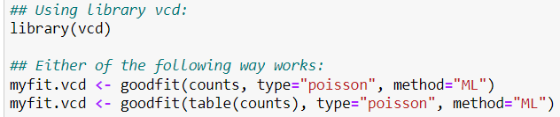
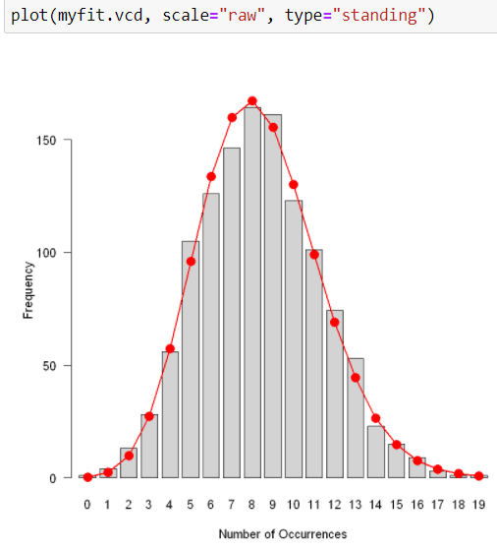
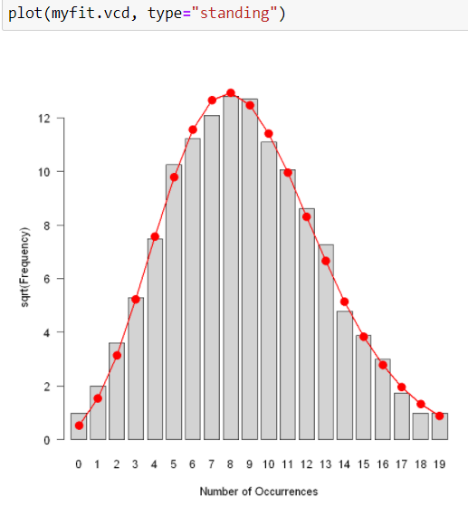

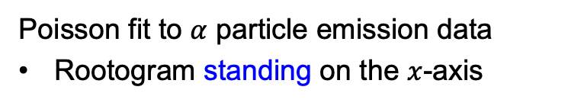

Rootogram by library(vcd)
Poisson fit to $α$ particle emission data
Rootogram standing on the $x$-axis
Observe the difference:
$$n_{j}$$
$$\sqrt{n_{j}}$$

Slide 15
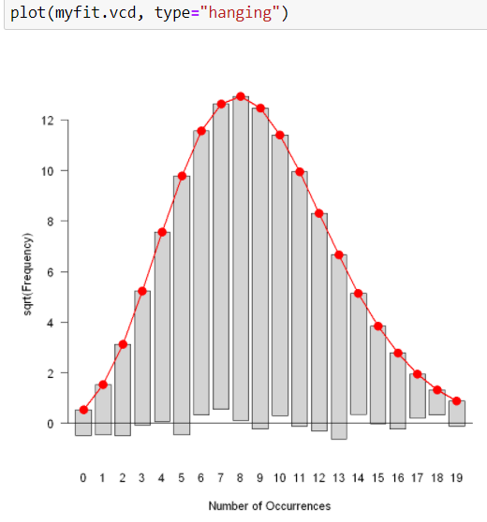
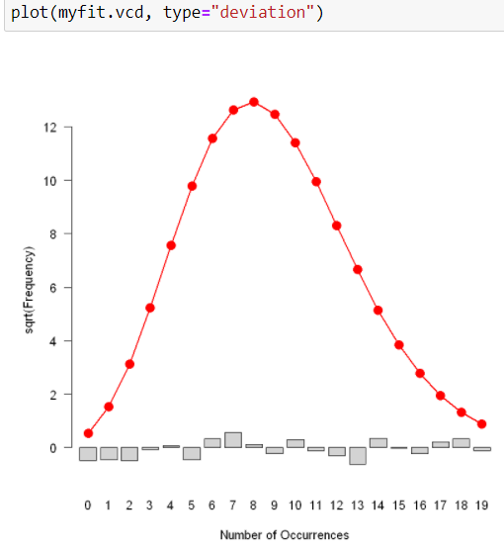
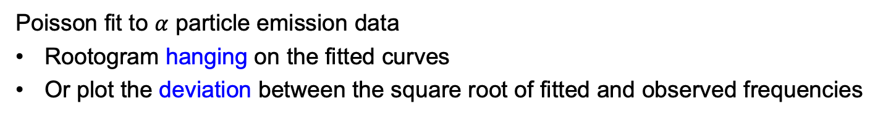

Rootogram by library(vcd)
Poisson fit to $α$ particle emission data
Rootogram hanging on the fitted curves
Or plot the deviation between the square root of fitted and observed frequencies
$\sqrt{{\hat{n}}_{j}}−\sqrt{n_{j}}$

Slide 16
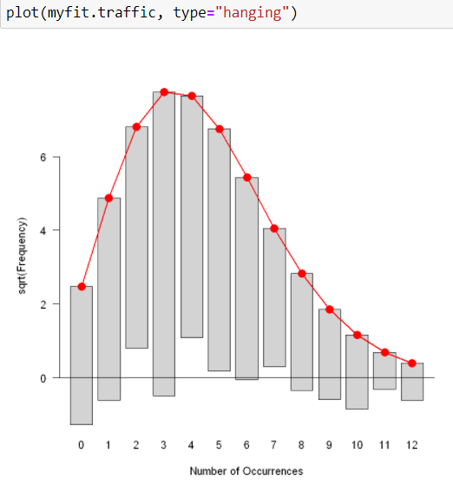

Rootogram by library(vcd)
Poisson fit to traffic flow data.

Slide 17




Rootogram by library(vcd)
Gamma fit to precipitation data
Need some pre-processing here, before passing to vcd::rootogram()

Slide 18



Q-Q Plot (quantile-quantile plot)
Compare empirical distribution of a sample to a theoretical distribution
Compare empirical distributions of two samples
If the theoretical is a normal distribution, it is called a normal Q-Q plot.
Order statistics and empirical distribution
$x_{(k)}$ corresponds to the $\frac{k}{n+1}$ quantile of the empirical.
Theorical CDF: $F(x)$, then the corresponding quantile: $F^{−1}\left(\frac{k}{n+1}\right)$
If $X\sim F(X)$, we expect $F_{n}\left(x\right)≈F(x)$, or $x_{(k)}≈F^{−1}\left(\frac{k}{n+1}\right)$

Slide 19



Q-Q Plot by fitdistrplus
Gamma fit to precipitation data
Both fits are poor at the tail.
The MLE is worse.
(To study extreme weather, the tail is more interesting.)

Slide 20






Normal Q-Q Plot by qqnorm
[Ref: Section 9.8, MSDA3 - J. A. Rice]
(a)
(b)
(c)
(d)
Compare data to the standard normal $N\left(x | 0, 1\right)$
Reference line: $y=x$
See weather the data follows a Gaussian
Reference line passing through $\frac{1}{4}$ and $\frac{3}{4}$ quantiles
Notes:
（a）fits well;（b）deviate in location;（c）deviate in scale；（d）deviate in shape

Slide 21


单选题
1分
Which of the following distribution is the most likely one to produce data in the normal Q-Q plot below?
A
Normal distribution
B
Exponential distribution
C
Uniform distribution
提交
Notes:
Answer: B

Slide 22





Some Patterns in Normal Q-Q Plot
Normal: linear relation
Bimodal: two branches
Heavy-tailed: many extreme values on the $y$-axis
Note: “heavy-tailed” in comparison to the Gaussian
Light-tailed: $y$ values are saturating
Left-skew: …
Right-skew: …
Notes:
Sometimes bimodal and light-tailed are difficult to differentiate. One can combine it with histogram or other graphics.
Exponential is said “heavy-tailed” when comparing to normal; generally, we do not say it is heavy-tailed.

